Slide 1
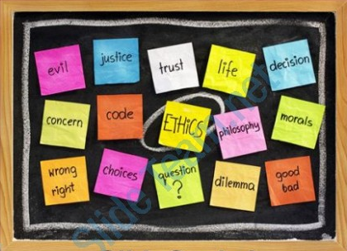
Upholding Ethics and Integrity
Central Board of Secondary Education

Slide 2
What is Integrity?

Slide 3
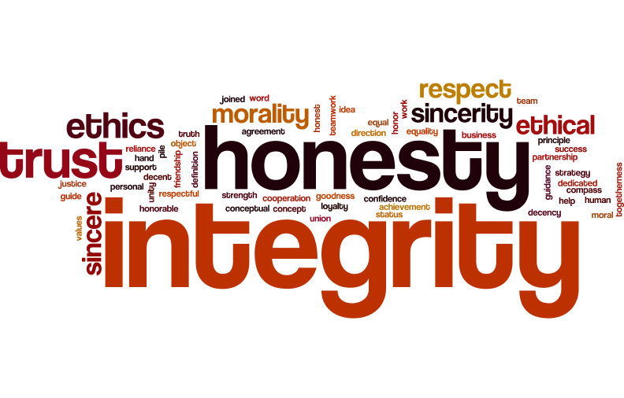

Slide 4
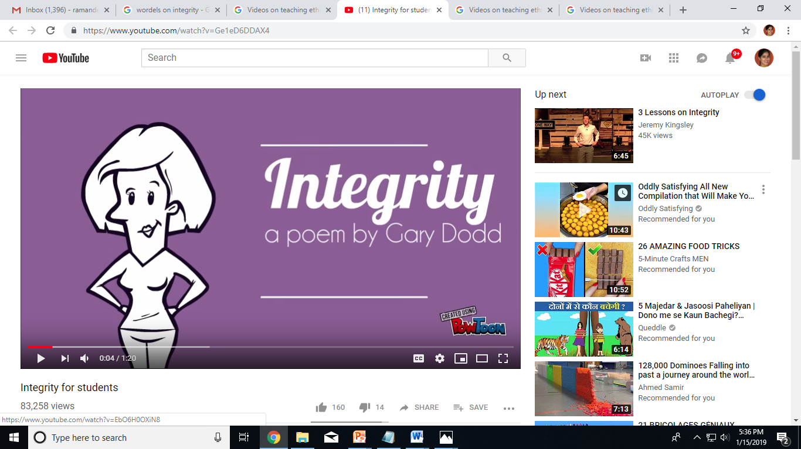
Video_Integrity_1
Source: https://www.youtube.com/watch?v=Ge1eD6DDAX4

Slide 5
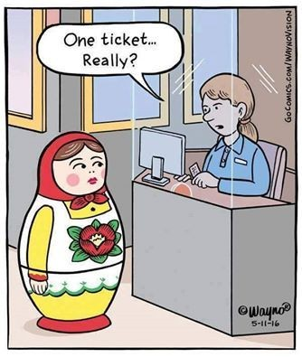
Honesty at all Times
Matryoshka dolls or Russian dolls, are
the set of wooden dolls of decreasing size placed one inside another.

Slide 6
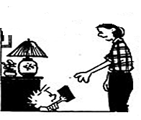
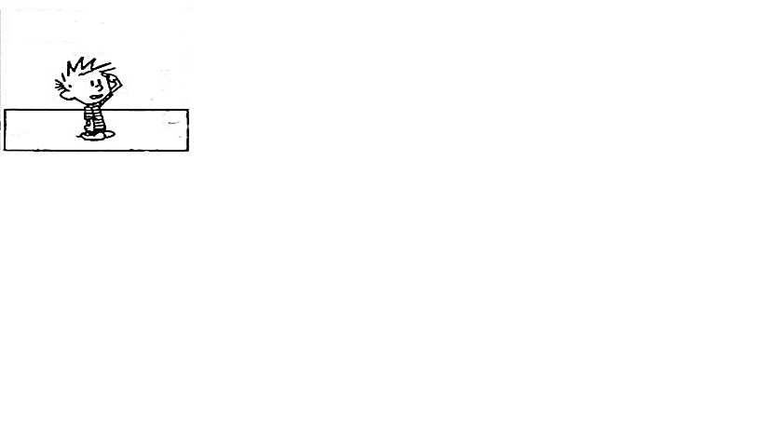
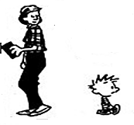
What do you think of it?
I read this Ethics
Book You got me.
I am glad you
enjoyed it.
It really made me see
things differently. Its given me a lot to think about.
It’s complicating My Life. Don’t Get me any more.
Calvin and Hobbes

Slide 7
In this room we don’t do
EASY
we make easy happen
through
HARD WORK and LEARNING

Slide 8
Discussion Points
What do all of these definitions /statements have in common?
Is integrity something that one can impose on someone else?
Give an example of unethical behaviour that you may have come across.
Is adopting unfair means during exams, a case of unethical behaviour? Why?

Slide 9
THE BAD NEWS!

Slide 10
Rise of Cheating Culture
Blatant breaking of rules to get ahead academically, professionally, or financially.
Sometimes it involves breaking or violating laws, sometimes it does not.
It may even be done by people who hold “respectable” positions.
These are people who prefer taking an unethical route to reach their destination.

Slide 11
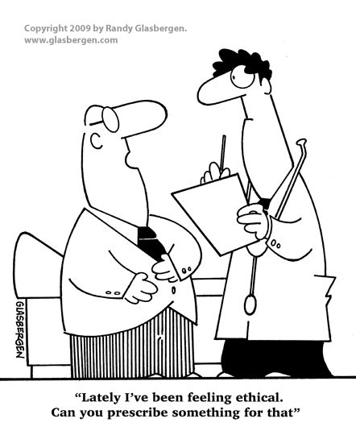
Some people feel it is cool to be
unethical
“Lately I’ve been feeling ethical. Can you prescribe something for that.”

Slide 12
Every unethical practice has its consequences.

Slide 13
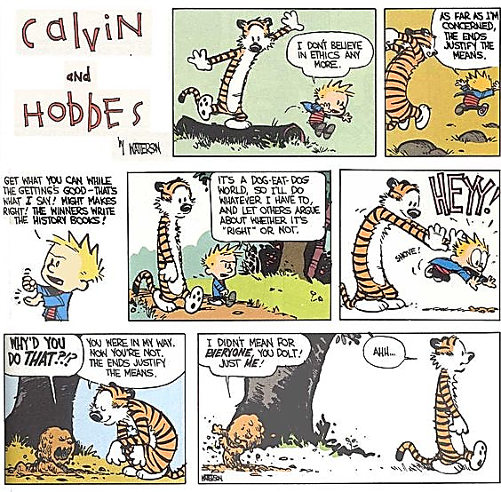
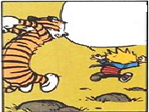
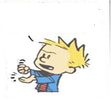
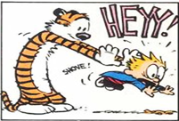
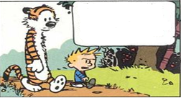
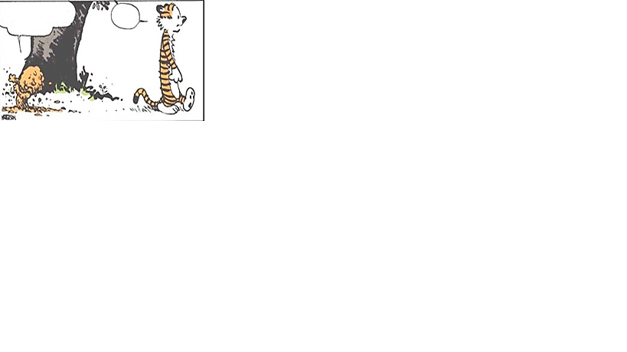
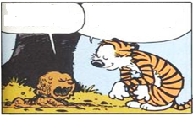
Cheating hurts the Cheater too
Get what you can while the Getting’s Good - That’s what I say! Might makes Right! The winners write the History Books.
As far as I’m concerned, the Ends justify the Means
I don’t believe in Ethics anymore
It’s a Dog eat Dog World, so I’ll do whatever I have to, and let others argue about whether it’s Right or Not.
I didn’t mean for Everyone. You Dolt! Just Me!
AHH…
You were in my way. Now you’re not. The Ends justify the Means.
Why’d you do that??
Calvin and Hobbes

Slide 14
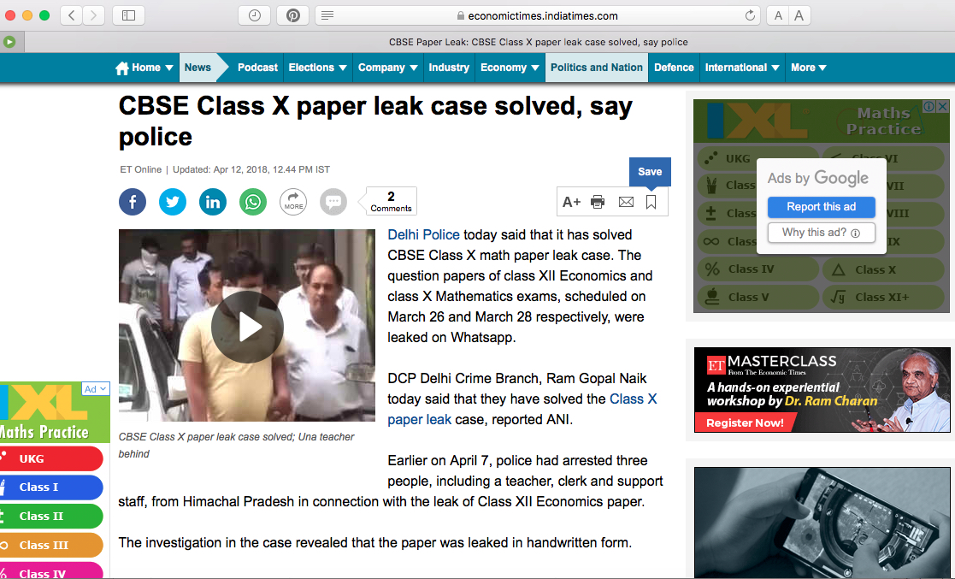
Culprits arrested.
Every person who
received or
forwarded
the papers identified and investigated.
CYBER CRIMES CAN
BE NAILED.

Slide 15
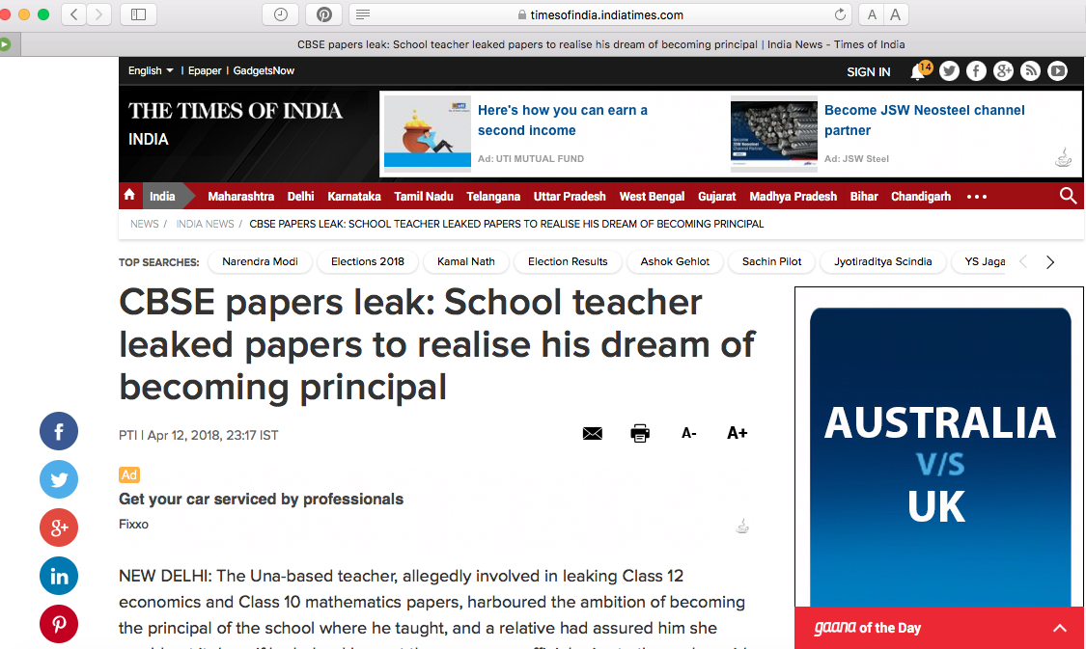
Who is to be
blamed….
System
or
Individuals???

Slide 16
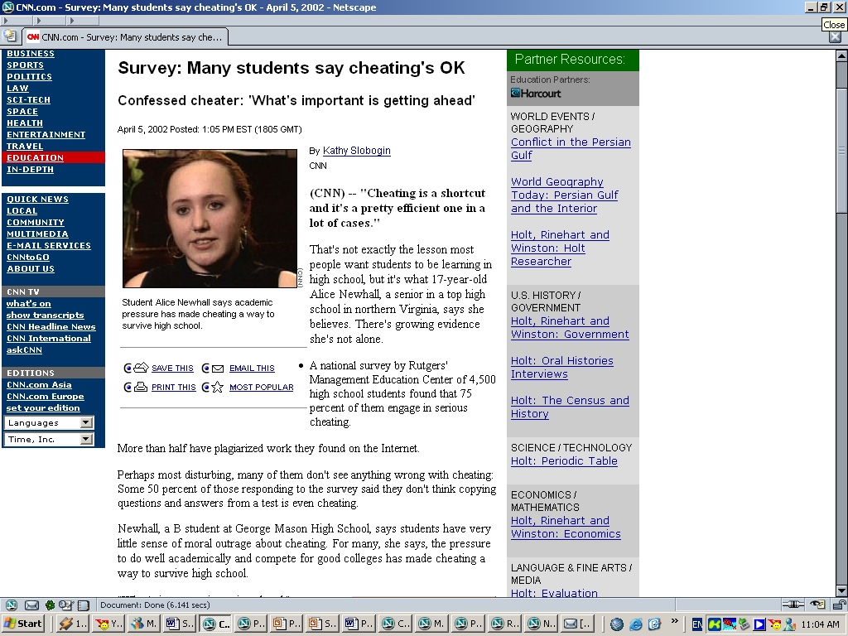
“What’s important is getting ahead ...
Cheating is a
shortcut and it’s a
pretty efficient one in a lot of cases.”
– Confessed cheater

Slide 17
Like in the previous case,
how would you feel if your
choices or actions were
front page news?

Slide 18
Discussion
What are the benefits, if any, of cheating or any other unethical practice?
What are the risks of being involved in any unethical practice?
Does an unethical act by one person harm many others too? How?
Who has the ‘responsibility’ for maintaining ethics in you?

Slide 19
Discussion……What if
You are appearing for your Board exams. Your classmate tells you that he knows people who will try and access the question papers of two subjects for him much before the board exams. He offers the papers to you at a price. He says that he has ensured all security, and nobody will come to know.
You are not very good at those subjects. If you get these papers, you will surely do well, and get admission in the College of your choice. If not, you may not get that admission.
What will you do?

Slide 20
Discussion……What if
You are appearing for your Board exams. You take coaching for a particular subject that you are not very comfortable with. Your parents have spent a substantial amount on your coaching, even though they cannot afford it. However, despite the coaching you are not confident that you will do well in the subject.
On the day of the exams for that subject, just an hour or two before, your coach calls you up and tells you to reach his place as he has access to the actual question papers, and he could prepare you enough within an hour to ensure you do very well in that subject.
What will you do?

Slide 21
Discussion……What if
You have just appeared for the first paper of your Board exams. You have three days to prepare for the next one. Your friend calls up excitedly to inform you about a YouTube link on which the question paper of your next exams has purportedly been leaked.
He informs you that your group of friends are meeting at his place in the evening to solve the paper and to be better prepared for the exams.
He informs you that since it is on social media, and he did not ask or pay for it, there is no unfair means involved in doing this.
What will you do?

Slide 22
Discussion……What if
You are sitting in the examination hall taking the exams of the subject that you feel is rather difficult. Your friend knows about your feelings for this subject. When he sees the QP he realizes you will need help. He writes answers on his handkerchief and tries to grab your attention and pass it on to you.
What will you do?

Slide 23
CHEATING
Cheating is a crime under law
Section 420 in The Indian Penal Code
—Whoever cheats and thereby dishonestly induces the person de­ceived to deliver any property to any person, or to make, alter or destroy the whole or any part of a valuable security, or anything which is signed or sealed, and which is capable of being converted into a valuable security, shall be punished with imprisonment of either description for a term which may extend to seven years, and shall also be liable to fine.

Slide 24
Cheating takes various forms
A few examples
Music/Movie downloaded from the Internet or off a peer sharing site without paying for it
Using mobile phones to text message answers, back and forth, take pictures of test, save notes/cheat sheets digitally
A video clip “lifted” without permission or acknowledgment
Using an online translator to translate work into another language and turning it in as one’s own writing in a different language
Using calculator memories to store notes/cheat sheets
Using an image, text or art work from a book, magazine, newspaper, pamphlet etc. or the Internet without referencing

Slide 25
Cognitive Dissonance
A psychological term that refers to ways we deal with the new information that runs contrary to our values.
For example, we all know that it’s wrong to steal, but many of us would be willing to take organization's adhesive tape or pen or paper for our personal use.
To resolve the dissonance that results from doing something we know is wrong, we might say to ourselves, “It is nothing expensive” or “there is a plenty here” or “this is a small compensation for the salary which I deserve but don’t get paid”
(Even worse is that some would not even feel any dissonance and simply take the things without even giving a second thought)

Slide 26
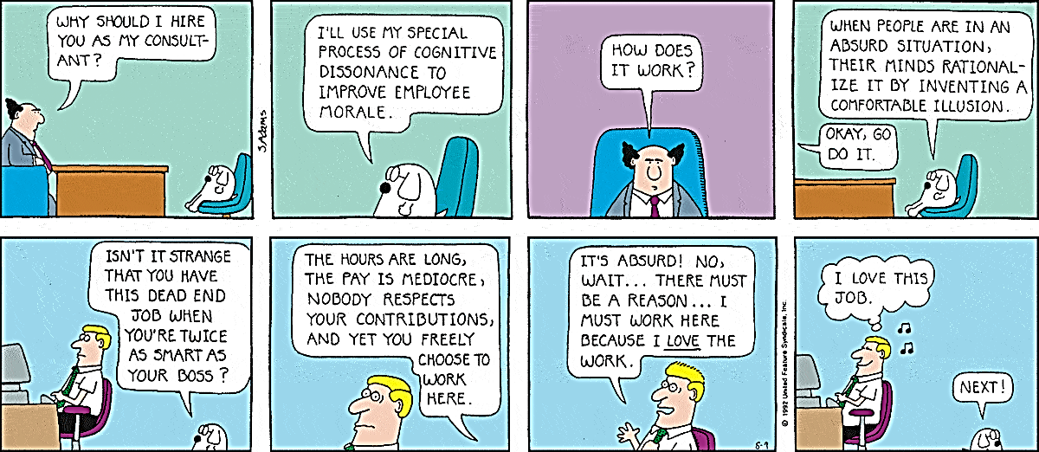
Cognitive Dissonance by Scott Adams

Slide 27
Right or Wrong
What determines it according to research
Level and Age | Stage | What determines right or wrong
Level 1 (Pre-Conventional): Upto the Age of 9 years | Obedience and punishment orientation | Right and wrong defined by what they get punished for. If you get told off for stealing then obviously stealing is wrong.
 | Instrumental-Relativist (Self-interest orientation - What's in it for me?) | Similar, but right and wrong is now determined by what we are rewarded for, and by doing what others want. Any concern for others is motivated by selfishness.

Slide 28
Right or Wrong
What determines it according to research
Level and Age | Stage | What determines right or wrong
Level 2 (Conventional): Most adolescents and adults | Interpersonal accord and conformity (The good boy/good girl attitude) | Being good and to do whatever pleases others. The child adopts a conformist attitude to morality. Right and wrong are determined by majority.
 | Authority and social-order maintaining orientation (Law and order morality) | Being good now means doing your duty to society. To this end we obey laws without question and show respect for authority. Most adults do not progress past this stage.

Slide 29
Right or Wrong
What determines it according to research
Level and Age | Stage | What determines right or wrong
Level 3 (Post-Conventional): 10 to 15 % of the over 20s | Social contract orientation | Right and wrong now determined by personal values, although these can be over-ridden by democratically agreed laws. When laws infringe our own sense of justice we can choose to ignore them.
 | Universal ethical principles | We now live in accordance with deeply held moral principles which are seen as more important than the laws of the land.

Slide 30
Intervention Points
There are three checkpoints where intervention in the cheating process is possible.
The formation of the intention to cheat (academic integrity, values education, honor codes/rules)
Carrying out the intention (designing foolproof assessments/encrypted papers, vigilant proctoring of exams)
Catching those who have already cheated (defining rules and regulations for use of unfair means)
Formation of the
Intention to Cheat
Act of Cheating
Academic Integrity
and values education
Approaches
Preventative
Approaches
Defining rules and
regulations

Slide 31

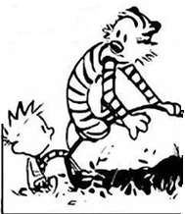
Hobbes, do you think our Morality is defined by our actions, or by what’s in our Hearts?
I think our Actions show that’s in our Hearts.
Calvin and Hobbes

Slide 32
What/Who has the most potential to create a positive effect on a Student’s Ethical Standards?

Slide 33





Highly Influential
Parents
Peers/ Friends
Teachers
Celebrities
TV/Internet/Social Media

Slide 34

Role Models
Teachers/Elders
Peers
Teach through example.
Teach the importance of integrity during the formative years of the students as it becomes a part of their life.
Someone hard working, creative and free thinking, easily become a peer role model.

Slide 35
Poor Role Models
A school teacher asked a little boy what his father did for a living.
The boy replied,
"I'm not sure, but I guess he makes pens, pencils, light bulbs, toilet rolls, etc., because that is what he brings home every day in his lunch box."
Youths are impressionable.
When they see their mentors--such as parents, teachers or political leaders-- cheating with pride or bragging about petty dishonesty such as stealing a towel in a hotel or cutlery from the restaurants, the following happens:
  They are disappointed.
  They lose respect for their mentors.
  Constant exposure breeds acceptance in them.

Slide 36
5 Steps to Ethical Decision Making
Recognize an Ethical Issue
Get the facts
Evaluate Alternative Actions- what is right, what is wrong
Make a decision and Test it
Act and Reflect on the Outcome

Slide 37
Discussion……ethical dilemmas
You are India’s most famous cricketer. You are offered Rupees 20 crores endorsement amount to promote a product that you dislike and will never use yourself. You are also aware it is bad for the environment.
Will you endorse it?

Slide 38
Discussion……ethical dilemmas
You are participating in the CBSE sports meet. You have just crossed your age category one week back. However, you know that you are no match to the new age category in which you belong. You are really passionate about your sport and have been doing extremely well at it. A person who matters offers to hide your date of birth to give you advantage.
What will you do?

Slide 39
Discussion……ethical dilemmas
You are backing your car into a tight parking space in the Mall. You accidentally scrape the neighbouring car parked there. You don’t know whose car it is, nobody saw you make this mistake, and there are no CCTV cameras there.
What will you do?

Slide 40
In the previous case, will you leave a note giving your name and contact details, taking responsibility and offering to take care of the damage?

Slide 41
Conflicts/Issues faced by Students
Which lead to unethical practices/acts
Stage | Issues to be Handled | Response
Pre Examination Stage | Anxiety created by peers when they share they have completed their syllabus | Such dilemmas which are due to anxiety should be solved with calmness and faith in oneself. Positive reinforcement/counselling helps a lot in such cases.
 | Low Confidence levels | This needs positive self-talks/Pep-talks. Do not hesitate to take support from parents and teachers.
 | Urge to adopt unfair means and Peer connivance to seek help through unsolicited means and modes | Relate the act with the consequence that one might face. Proper counselling and intervention required and must be sought. Counselling by school.

Slide 42
Conflicts/Issues faced by Students
Which lead to unethical practices/acts
Stage | Issues to be Handled | Response
Examination Stage | Cheating and hunting for help | May lead to expulsion and debarment.
 | Urge to garner support from invigilators by bribing them | Need to value and respect the sanctity of examinations. Focus on preparation for exam instead of wasting time in such pursuits.
 | Impersonation | Awareness building required around the fact that it may lead to serious legal consequences, including imprisonment

Slide 43
Conflicts/Issues faced by Students
Which lead to unethical practices/acts
Stage | Issues to be Handled | Response
Post Examination Stage | Making request/using influence to increase the marks | Need to understand and respect the sanctity of the exam. It can be turned into a case of UFM.
 | Tracking of answer sheets by bribing the officials | Will lead to serious issue on getting caught. People may fool by robbing off the money.
 | Influencing results by power of might | Can result in legal implications.

Slide 44

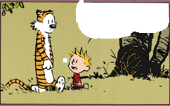

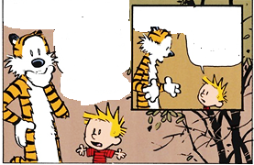

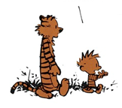
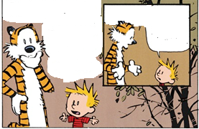

Calvin and Hobbes
Today at school, I tried to decide whether to cheat on my test or not.
I wondered, is it better to do the Right thing and fail… or is it better to do the wrong thing and succeed.
On the one hand, undeserved success gives no satisfaction. … But on the other hand, well deserved failure gives no satisfaction either.
Anymore, simply acknowledging the issue is a moral victory.
Well, it just seemed wrong to cheat on an Ethics Test.
Then I thought, Look, Cheating on one little Test is not such a big deal. It doesn’t hurt anyone. …But then I wondered if I was just rationalizing my unwillingness to accept the consequence of not studying.
Of course, most everybody Cheats some time or other. People always bend the Rules if they think they can get away with it…Then again, that doesn’t justify My Cheating.
Still, in the real world, people care about success, not principles…Then again, maybe that’s why the world is in such a mess. What a Dilemma!
So what did you decide?
Nothing, I ran out of time and I had to turn in a Blank Paper

Slide 45
How to Deal with Exam Stress
Believe in Yourself
Work Hard, Stay Focused with positive energy
Get Organized
Make a list of everything you need to study & create a schedule
Make Sleep a Priority
A good sleep of between 7-9 hours every night helps to have a relaxed and well rested mind and body
Overcome Problems
Believe in yourself and have the confidence to succeed
Take action to address the problems directly

Slide 46
How to Deal with Exam Stress
Exercise Daily
20 minutes physical activity a day can help to improve focus and keep you relaxed
Eat Right
Eat 3 healthy meals a day & have power foods for the brain like nuts, etc.
Talk about your nervousness
Nervousness is a natural reaction to exams, don’t bottle it. Talk to your friends & family about your feelings
Keep Things in Perspective
The exams might seem like the most crucial thing at present but in the larger picture of your life they are just a small thing.

Slide 47
Offered by trained counsellors, psychologists, social scientists & school Principals
Voluntary, free of cost service
Offered twice a year
Phase I- Pre Exam, Feb. to April
Phase II- Post Result, May to June
Timings : 8 AM to 10 PM on all days
Centralized Toll Free Access in India
Students have the facility to dial a toll free number 1800-11-8002 from any part of the country to get centralized access to CBSE helpline.
CBSE
Tele Counselling Services

Slide 48
If you come across anyone around you practicing or engaging in unethical practice related to exam question papers, you can report/share about it to the following in the given order. This will help us to initiate appropriate action.
Please contact
Parents | Will inform Board Authorities
Class Teacher
School Principal
Tele-counsellor
Regional Officer | Will initiate appropriate action
Controller of Examination
Secretary
Chairperson

Slide 49
Cheating/adopting unfair means in exams is unethical
UFM will be caught
Action is always taken by the Board against student found indulging in UFM
Report card will also have the word “UFM” printed on it
You may lose a year if you are a case of UFM
Social media always leaves a trail and it is possible to catch culprits using it for UFM
You alone will be responsible for spoiling your future if you indulge or support any UFM
Avoid sensationalizing on the public domain as it leads to rumour mongering and panic
Ethics is the cornerstone of progress
REMEMBER

Slide 50
“I hope you live a life you’re proud of.
If you find that you are not, I hope you have the strength to start all over again”
-F. Scott Fitzgerald

Slide 51
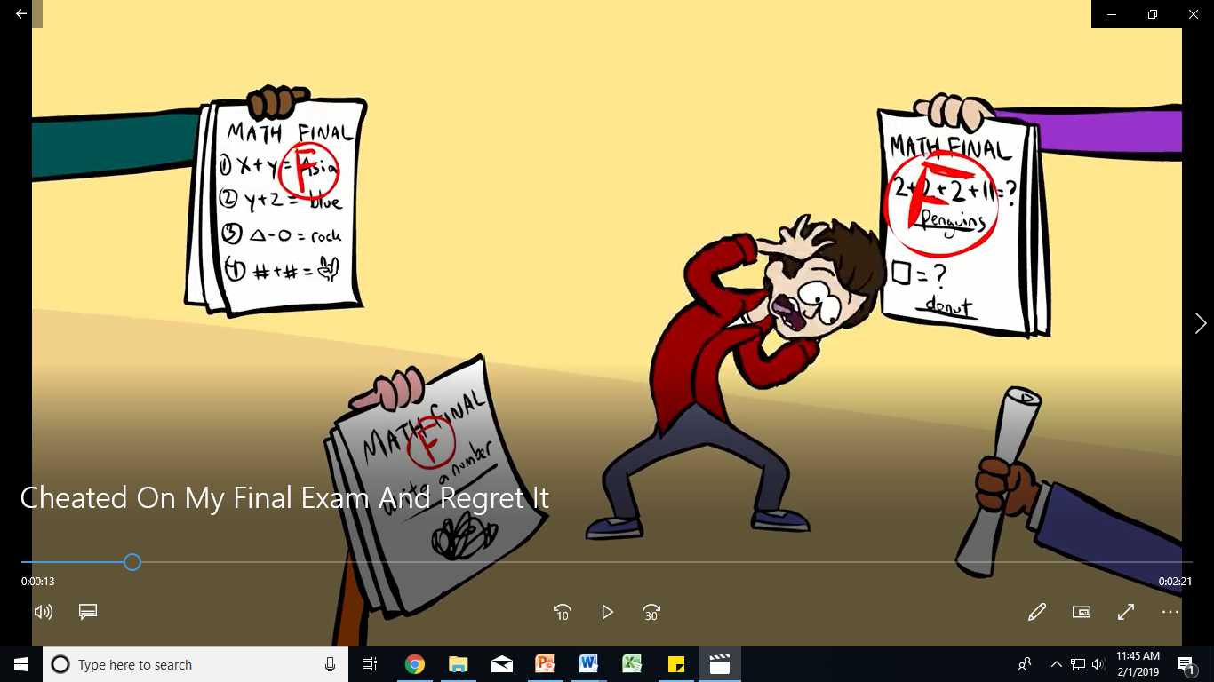
Video_Integrity_2
Source: https://www.youtube.com/watch?v=g5NglKjXq3Y

